Slide 1


BIOMETRIC VEHICLE ACCESS (FINGERPRINT CAR SECURITY SYSTEM) CS690AH2 - HCI
Presented by
Sneha Palvai.

Slide 2
Synopsis
Aim
Existing system and its Problems
Proposed Infotainment system
Principles
Advantages
Problems/Inhibitors
Things Learnt
Conclusion
Notes:
Existing system and its Problems
Proposed system
Design Approach
Principles
Scenario
Storyboard Sketching
Advantages
Problems/Inhibitors
Conclusion

Slide 3
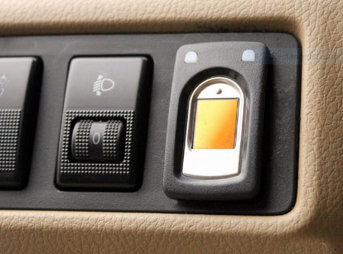
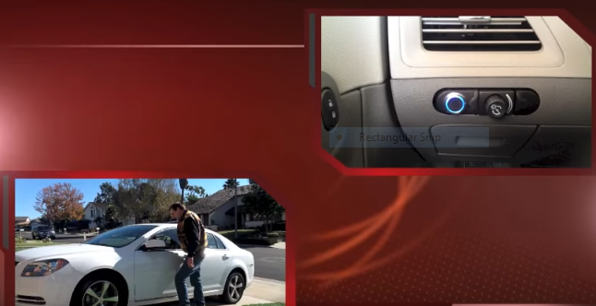

AIM
The main aim of this project is to help users secure their car with the help of Biometric access.

Slide 4
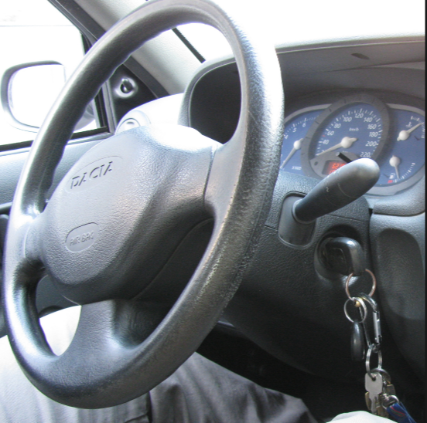
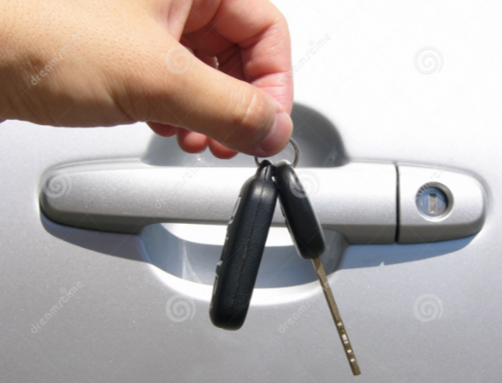

problems with external keys
Sometimes, its very frustrating if we lost keys and open door by applying some physical effort.

Slide 5
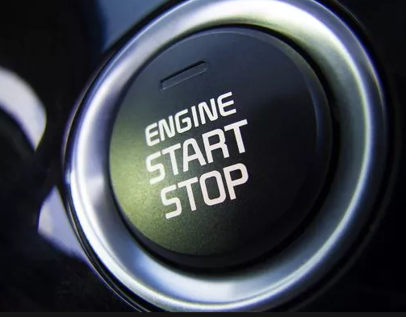
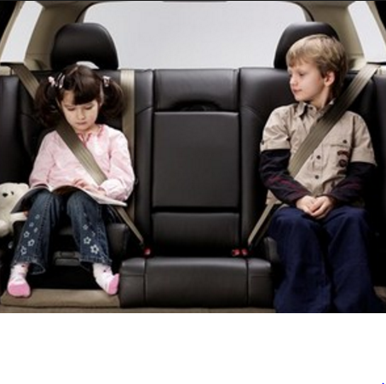
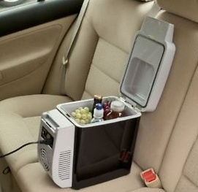

Overview of My infotainment summary

Slide 6
TEXTUAL HIERARCHICAL TEXTUAL ANALYSIS (HTA) DESCRIPTION
In order to use my fingerprint access featured car.
The user has to buy a biometric car and register with their name.
Give his fingerprints to access.
Synchronize his car access to his mobile phone.
By using his touch access, detect his vehicle parking location
5.1 Start keyless engine
5.2 Fix his/kid’s seatbelt
5.3 Save his important documents
5.4 Grab drinks/food by giving access to mini refrigerator in his car
Reach the destination and Stop the engine.
Detach seatbelts, place car in a proper parking lot and close the car door.
Plan 1: Do 0-1-2-3-4 until the destination is reached and then do 6 and 7.
Plan 5: Do 5.1, 5.2 in an order and then depending upon user requirements he can do either 5.3 or 5.4

Slide 7
PRINCIPLES USED
Flexibility: For example, user can easily use his open/close door to access which is very flexible for him.
Low physical Effort:
Tolerance for error: Less prone to errors
Size and space: Small circular size and precise
Internal locus of control: For example, the inbuilt software recognizes finger touch access as soon as user tries to use and function accordingly.

Slide 8
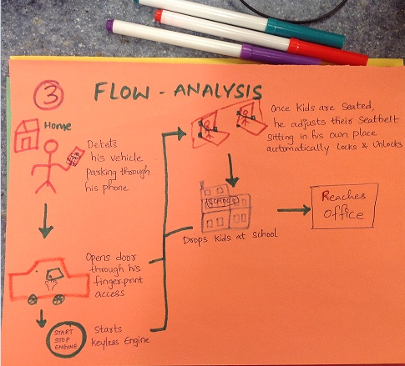
Example of user’s interaction with my product

Slide 9
ADVANTAGES
Facilitates lock/unlock door
Start keyless engine
View history
Secure documents
Fix seatbelt
Grab food from mini-refrigerator.

Slide 10


PROBLEMS/INHIBITORS
Cannot be implemented in rural/remote areas.
Difficult to afford the cost for Economic people.

Slide 11
THINGs LEARNT
Helped me to think more from user’s perspective.
Persona & Scenario helped me to improve my imagination and creative skills.
Gained knowledge on HCI principles.
Gained interest to watch shark Tank Episodes.

Slide 12
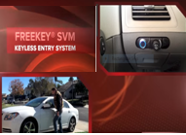
conclusion
Finally, I would like to conclude that adapting advanced fingerprint biometric access is very useful for authentication purpose as well enjoying luxurious features in car.
My video link: https://youtu.be/ua2T-jM_QJ0

